Slide 2
Agenda
Welcome and Overview of Major Themes
Remarks from Federal Leaders
Mini Panel Discussions:
Reducing Burden of Respiratory Infections
Reducing Burden of OUD/SUD
Panel Discussion:
Path to Improving US Health Through Public-Private Collaboration
Closing Remarks and Next Steps

Slide 3
Planning Group
Expert Members
Bechara Choucair, Kaiser Permanente
Dave Chokshi, NYU Grossman School of Medicine
Karen DeSalvo, Google
Carlos del Rio, Emory University
Megan Ranney, Yale School of Public Health
Anne Zink, Alaska Department of Health & Association of State and Territorial Officials
Fred Cerise, Parkland Health & Hospital System
Marc Harrison, General Catalyst
Melissa Harvey, HCA
Rhonda Medows, formerly Providence
NAM and DM Leadership
Victor Dzau, National Academy of Medicine
Mark McClellan, Duke-Margolis Center for Health Policy
Michael McGinnis, National Academy of Medicine

Slide 4
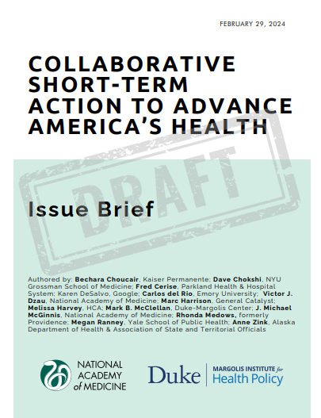
Overview of Collaborative
We are focusing on opportunities now for collaborative steps to improve the nation’s health
This new Issue Brief summarizes
Foundational elements for progress
A set of feasible, meaningful action steps across health care, public health, and community supports to improve our nation’s capacity to respond to two population health priorities
Notes:
Victor Intro

Slide 5
Short-Term Opportunities for Improving Population Health
Strengthening protections for individuals and communities from the complications and disruptions of respiratory infections
Preventing overdose deaths and other complications of opioid use disorder (OUD)
Areas with near-term opportunities for progress, through Federal policy supports that enable collaborative action at the local, state, and national level

Slide 6
Foundational Steps for Short-Term Progress
These policy actions can enable progress across a range of public health challenges, including protection from respiratory illness and OUD complications:
Improving use of electronic data to inform public health threat awareness and action through systems standards and integration.
Leveraging health care payment and delivery reforms to increase health care capabilities to improve population health
Strengthening effective and accountable community health collaborations across public health, health systems, social services, and community organizations.
Helping trusted health care and community organizations provide timely and accurate information that individuals, families, businesses, and community organizations can use to make decisions about their health
Notes:
[Intro these themes to guide the two mini-sessions – then pull down slides]

Slide 7
Path to Improving US Health Through Public-Private Collaboration
What synergies do you see between your current public-private collaboration and the further action steps discussed today?
With the current challenges facing public health in America, including tight funding for public health agencies, how will these steps help make progress?
Beyond respiratory viruses and OUD, what do you see as other top pressing population health priorities for action in the next 18 months – and how do the?
Notes:
Charlene Wong, Megan Ranney, Bechara Choucair, and Rhonda Medows, Moderated by Mark

